Slide 1
neoclassical.ai
Life Related Assemblies
Notes:
Hi. Welcome to this episode of Emergent Nature.
My name is J Mark Morris. I go by Mark.
In this episode I’ll discuss the error that caused science to go off track into general relativity and quantum mechanics.
That may seem like an unusual thing to say, since general relativity and quantum theory are generally considered to be successful effective theories.
However, as we will see, an error circa 1900 threw science off track.
There is a parsimonious solution to nature.

Slide 2
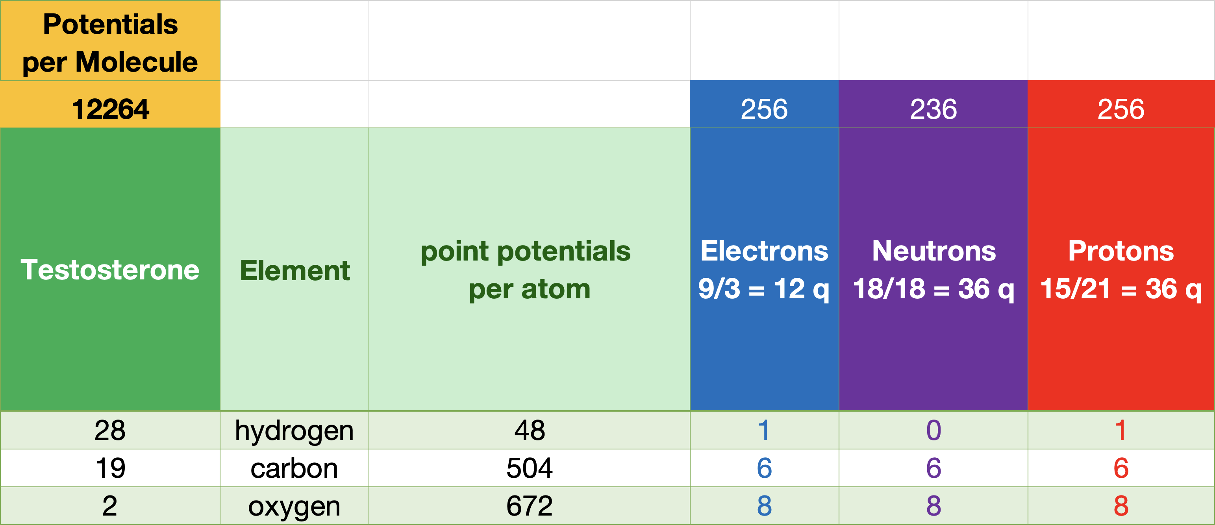
Testosterone C₁₉H₂₈O₂ is an assembly of 12264 Point Potentials
Consider this testosterone molecule assembly. C₁₉H₂₈0₂
Each atom contains many protons, neutrons, and electrons.
Protons and neutrons consist of quarks.
All of the above are sub-assemblies of point potentials
J Mark Morris

Slide 3
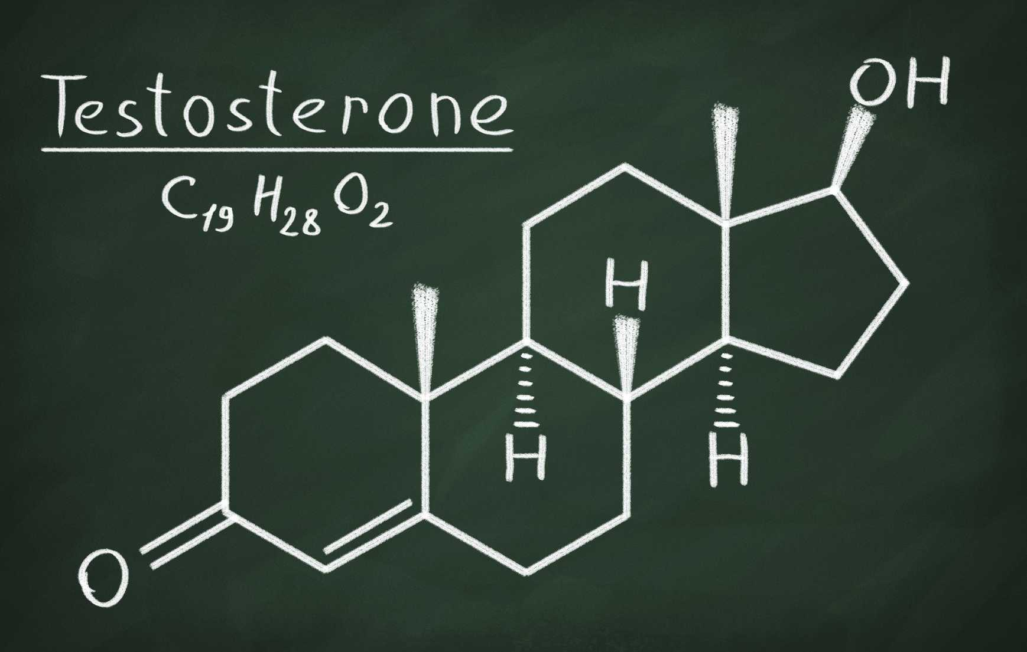
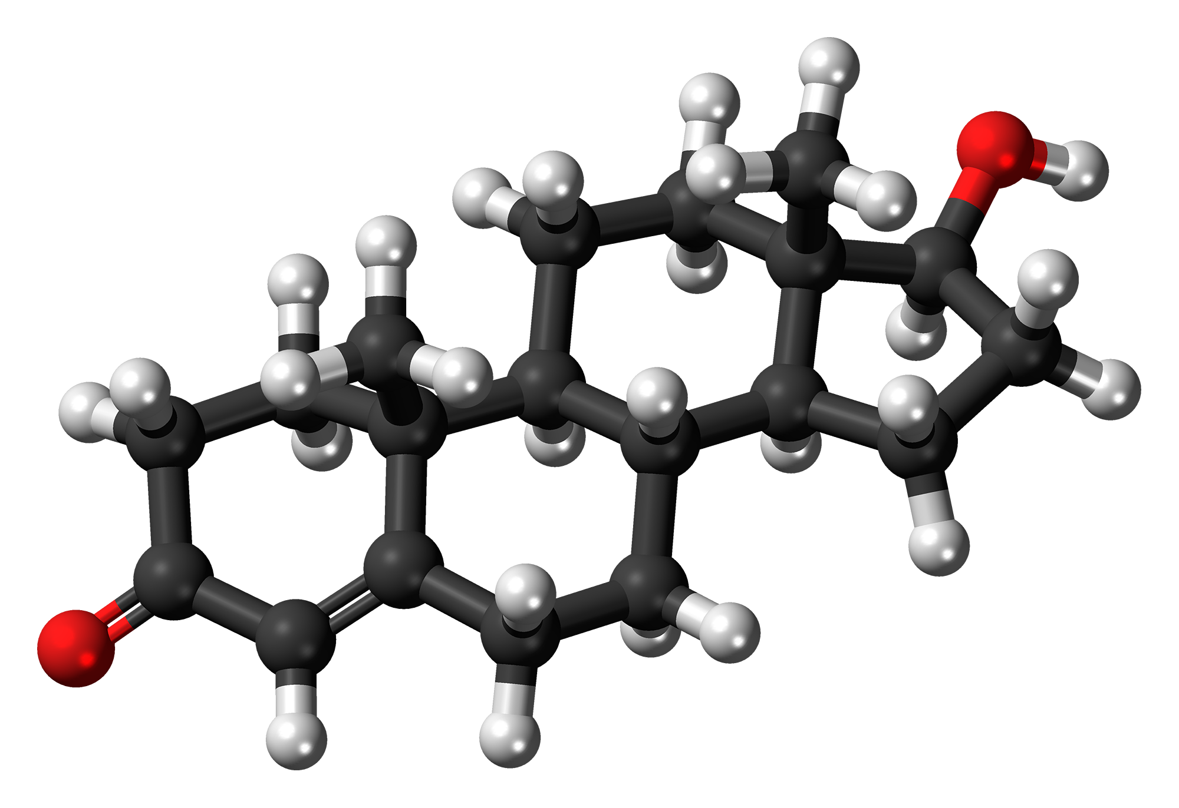
Carbon C, Black
Hydrogen H, White
Oxygen, O: Red

Slide 4
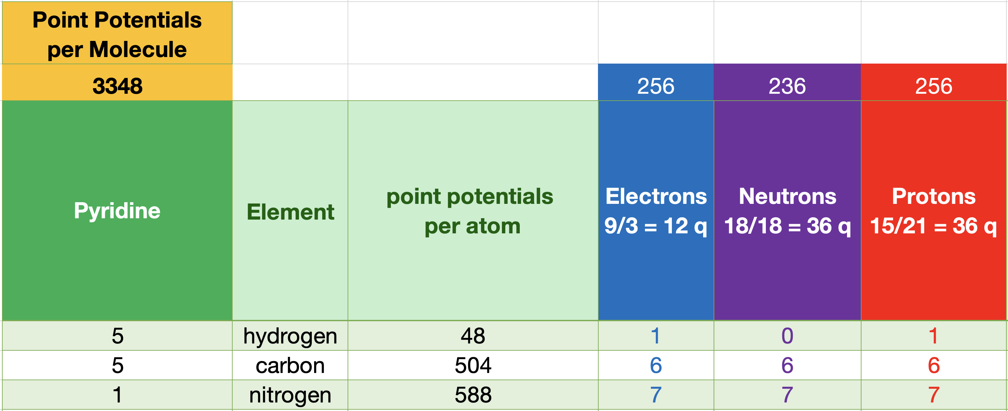
Pyridine C₅H₅N is an assembly of 3348 Point Potentials
Pyridine is a basic heterocyclic organic compound with the formula C₅H₅N.
Pyridine forms the basis for the amino acids tryptophan and niacin.
J Mark Morris

Slide 5
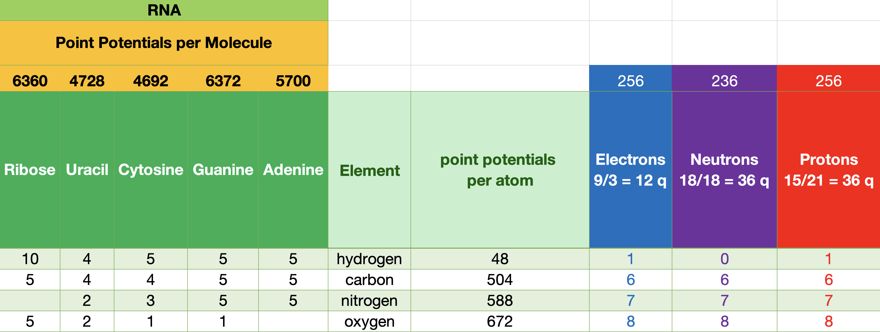
RNA Molecular Assemblies Range from 4728 to 6372 Point Potentials
RNA (ribonucleic acid) molecules are essential for various biological functions, including the processes of protein synthesis and gene regulation.
Structure: RNA is typically single-stranded, whereas DNA is double-stranded.
RNA has a backbone made of ribose sugar, while DNA has deoxyribose.
J Mark Morris

Slide 6
neoclassical.ai
What Life Form has the Fewest
Point Potentials?
Notes:
Hi. Welcome to this episode of Emergent Nature.
My name is J Mark Morris. I go by Mark.
In this episode I’ll discuss the error that caused science to go off track into general relativity and quantum mechanics.
That may seem like an unusual thing to say, since general relativity and quantum theory are generally considered to be successful effective theories.
However, as we will see, an error circa 1900 threw science off track.
There is a parsimonious solution to nature.

Slide 7
neoclassical.ai
Nanoarchaeum equitans
Notes:
Hi. Welcome to this episode of Emergent Nature.
My name is J Mark Morris. I go by Mark.
In this episode I’ll discuss the error that caused science to go off track into general relativity and quantum mechanics.
That may seem like an unusual thing to say, since general relativity and quantum theory are generally considered to be successful effective theories.
However, as we will see, an error circa 1900 threw science off track.
There is a parsimonious solution to nature.

Slide 8
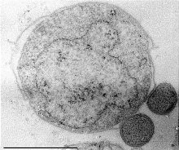
Nanoarchaeum equitans
The smallest living organism recognized by scientists is Nanoarchaeum equitans.
This microbe was discovered in 2002 in a hydrothermal vent off the coast of Iceland.
Its cells are only about 400 nanometers in diameter.
It has one of the smallest genomes of any sequenced microbe, with only 490,885 base pairs.
Its small size and minimal genome suggest it contains a relatively low number of atoms compared to larger organisms.
We know that RNA molecules cantain 4K-6K point potentials.
The genome therefore contains 500K x 10K ~= 5B point potentials.
h/t CoPilot and Wikipedia
Notes:
Hi. Welcome to this episode of Emergent Nature.
My name is J Mark Morris. I go by Mark.
In this episode I’ll discuss the error that caused science to go off track into general relativity and quantum mechanics.
That may seem like an unusual thing to say, since general relativity and quantum theory are generally considered to be successful effective theories.
However, as we will see, an error circa 1900 threw science off track.
There is a parsimonious solution to nature.

Slide 9
neoclassical.ai
Deinococcus Radiodurans
Notes:
Hi. Welcome to this episode of Emergent Nature.
My name is J Mark Morris. I go by Mark.
In this episode I’ll discuss the error that caused science to go off track into general relativity and quantum mechanics.
That may seem like an unusual thing to say, since general relativity and quantum theory are generally considered to be successful effective theories.
However, as we will see, an error circa 1900 threw science off track.
There is a parsimonious solution to nature.

Slide 10
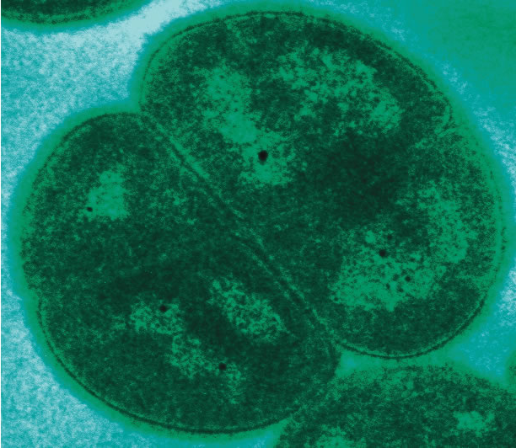
D. Radiodurans
Deinococcus radiodurans is a microbe and a bacterium with extraordinary survival capabilities
Microbe refers to any microscopic organism, which includes bacteria, viruses, fungi, and protozoa.
Bacterium is a specific type of microbe that belongs to the domain Bacteria.
D. radiodurans is a polyextremophilic bacterium known for its remarkable resistance to
radiation (i.e., various frequency photons)
cold (how does it radiate photons as a blackbody?)
dehydration (does not require water)
vacuum (does not require any surrounding gas, etc)
acid (is not reactive)
outer space for extended periods (low energy spacetime)
Its survival skills may emerge from its unique ability to repair both single and double stranded DNA.
h/t CoPilot and Wikipedia
Notes:
Hi. Welcome to this episode of Emergent Nature.
My name is J Mark Morris. I go by Mark.
In this episode I’ll discuss the error that caused science to go off track into general relativity and quantum mechanics.
That may seem like an unusual thing to say, since general relativity and quantum theory are generally considered to be successful effective theories.
However, as we will see, an error circa 1900 threw science off track.
There is a parsimonious solution to nature.

Slide 11
D. Radiodurans
DNA: Its genome consists of
two circular chromosomes,
one 2.65 million base pairs long
one 412,000 base pairs long,
a megaplasmid of 177,000 base pairs
a plasmid of 46,000 base pairs.
It has approximately 3,195 genes.
In its stationary phase, each bacterial cell contains four copies of this genome.
when rapidly multiplying, each bacterium contains eight to ten copies of the genome.
Proteins: It has a variety of proteins, including those involved in DNA repair,
such as UvrA, UvrB, UvrC, and UvrD2.
Carbohydrates: The biofilm matrix of D. radiodurans contains proteins and carbohydrates.
Pigments: It produces unique pigments,
especially carotenoids like deinoxanthin, which play a critical role in its radiation resistance.
Notes:
Hi. Welcome to this episode of Emergent Nature.
My name is J Mark Morris. I go by Mark.
In this episode I’ll discuss the error that caused science to go off track into general relativity and quantum mechanics.
That may seem like an unusual thing to say, since general relativity and quantum theory are generally considered to be successful effective theories.
However, as we will see, an error circa 1900 threw science off track.
There is a parsimonious solution to nature.

Slide 12
redundancy
self repair
radiation and reaction resistance
nil environmental requirements
D. Radiodurans
~10¹¹ atoms
~10¹⁴ point potentials
Notes:
Hi. Welcome to this episode of Emergent Nature.
My name is J Mark Morris. I go by Mark.
In this episode I’ll discuss the error that caused science to go off track into general relativity and quantum mechanics.
That may seem like an unusual thing to say, since general relativity and quantum theory are generally considered to be successful effective theories.
However, as we will see, an error circa 1900 threw science off track.
There is a parsimonious solution to nature.

Slide 13
Thank You
Questions?

